Slide 2
Presentation of information
for Social Care professionals
working with families using
FAMILY STAR method in POST – BREXIT ERA
25th of August 2020, Kells Ireland

Slide 3
Supporting the most vulnerable EU Citizens to secure their status after BREXIT is a responsibility of social care workers including family support workers, social workers, care leavers support workers and local authorities.
If any of your clients is an EU Citizens living in Ireland but working or/ and studying in Northern Ireland they MUST secure their right to continue studying and working in Norther Ireland after BREXIT by 31st December 2020
If any of your clients is an Irish citizen, they do not need to secure their settled status after BREXIT as there is a special agreement between the UK and Ireland (Irish Citizens only) but…If any of their family members is an EU Citizen (non Irish, non British) it is recommended to apply to the EU Settlement Scheme
More information https://www.dfa.ie/brexit/getting-ireland-brexit-ready/brexit-and-you/
https://www.gov.ie/en/campaigns/b2c18-getting-ireland-brexit-ready/?referrer=http://www.gov.ie/brexit/

Slide 4
European Union and EU27/ EEA/ EFTA
EU Settlement Scheme for EU27/ EEA/ EFTA citizens after BREXIT
Presentation of information for Social Care Workers working with EU Citizens in Poland, Ireland, UK

Slide 5
Content:
PART 1 EXPLANATION OF THE POPULAR TERMS
PART 2 EU SETTLEMENT SCHEME
PART 3 EVIDENCE

Slide 6
PART 1
EXPLANATION OF THE POPULAR TERMS

Slide 7
United Kingdom left the European Union (EU) on 31st of January 2020. This is the fourth extension since March 29th 2019.
When the UK leaves the EU, all EU27/EEA/EFTA citizens must apply to EU Settlement Scheme to secure their right to stay in the UK after BREXIT by 31st December 2020 in case of no deal, by 30 June 2021 in case of a deal.
Travel to the EU, Switzerland, Norway, Iceland or Liechtenstein will change if the UK leaves the EU with no deal.
We still do not know if the UK will leave the EU with a deal or no deal.
On the day you travel, you’ll need your passport to both:
have at least 6 months left & be less than 10 years old (even if it has 6 months or more left)
After Brexit your European Health Insurance Card (EHIC) card may not be valid.
You’ll need an international driving permit (IDP) to drive in some countries.
After Brexit you will not be able to use the existing pet passport scheme. Instead you’ll need to follow
a different process, which takes 4 months.

Slide 8
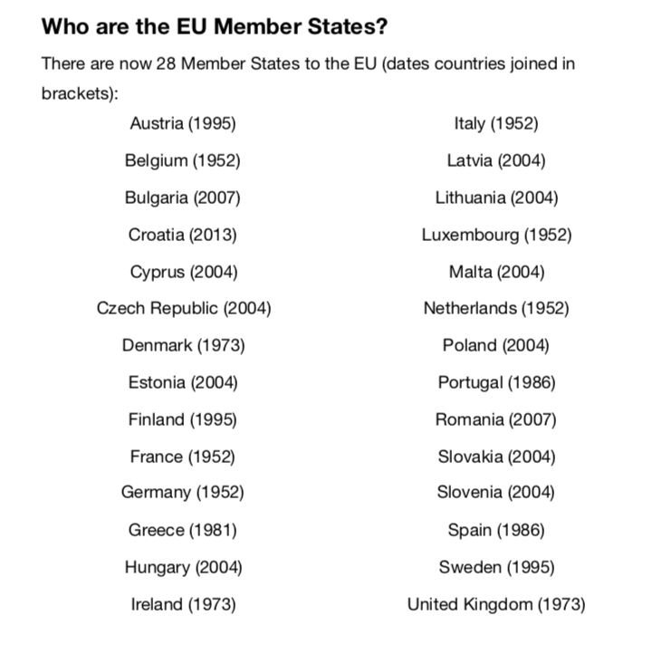

Slide 9
EU/EEA list of countries / citizens who must apply to EU Settlement Scheme
If you are, regardless of your origin, a passport holder of EU/EEA country you still must apply (unless one of the passports is British) to the EU Settlement Scheme:
The countries are: Austria, Belgium, Bulgaria, Croatia, Republic of Cyprus, Czech Republic, Denmark, Estonia, Finland, France, Germany, Greece , Hungary, Ireland*, Italy, Latvia, Lithuania , Luxembourg, Malta , Netherlands, Poland, Portugal, Romania, Slovakia, Slovenia, Spain, Sweden
EEA: Iceland, Liechtenstein, Norway
EFTA states: Iceland, Liechtenstein, Norway, (+Switzerland)
Brexit means that the arrangements and agreements of the UK’s membership of the EU will end
This includes the right of EU citizens to freely live and work in the UK.

Slide 10
A no-deal Brexit means the UK would leave the EU with no agreement in place and will become a third country.
If a special deal between EU leaders and UK politicians isn't agreed, then the UK could leave the EU with no deal in place. This would be a no-deal Brexit.
Changes in no deal BREXIT scenario example:
Some border checks could be re-introduced which means that a new immigration system will be introduces while going abroad
EHIC card won’t be acceptable if going abroad
New system in place for taking pets abroad
Transport and trade between the UK and the EU could be severely affected
Adults may not be able to drive in EU countries without a special driving licence
It could cost more money to use your phone abroad in EU countries no further funding for Universities from the EU
No free movement

Slide 11
I work in the UK, study in the UK, pay taxes,
I have a permanent residency card
Why do I need to apply?

Slide 12
PART 2
EU SETTLEMENT SCHEME

Slide 13
As a EU27/EEA/EFTA citizen your rights are secured under the EU law. When the UK leaves the EU, domestic law applies. The freedom of movement for workers is a policy chapter of the of the European Union.
To secure your rights you must apply to EUSS EU SETTLEMENT SCHEME asap
the government urges as there is longer period to wait for a decision.
Support from Immigration Adviser Level 1

Slide 14
To obtain settled status EU citizens and their family members will generally need simply to have lived continuously in the UK for five years. Those with less than five years’ residence will be granted pre-settled status until they accumulate their five years. For a year to qualify as being resident in the UK, we need six months of evidence (half of year and 1 day) from that 12 month period.
To lessen the burden on applicants, Home Office checks the employment and benefits records the Government holds based on National Insurance Number to establish the period of residence, meaning most applicants won’t need to do anything to prove their residence.
Where there are gaps, a wide variety of documents can be photographed and uploaded as evidence. Applicants can upload different types of evidence to demonstrate different periods of residence. (link to the list of documents added at the end of the presentation under ‘’Useful Links’’ section
Caseworkers will work proactively with applicants to help them evidence their qualifying period of residence in the UK by the best means available to the applicant.

Slide 15
There are two categories within the EU Settlement Scheme:
You need to apply to the Scheme
You don’t apply for a Settled or Pre – Settled Status so applicants regardless of the time of residency in the UK go through the same application process and questions.
You will be ‘offered’ a certain status at the end of your application
You may be offered a lower status – if you live in the country over 5 years and a SYSTEM offered you the PRE – Settled – DO NOT ACCEPT IT – contact us for further questions.
The Settled Status is based only on residency - you do not need to work to qualify for the Settled Status
SETTLED STATUS for applicants with five years continuous residence in the UK when they apply.
PRE-SETTLED STATUS for those who have not yet lived continuously in the UK for five years.
You can apply for Settled Status when you reach five years of continuous residence or when your pre-Settled Status expires.
But you must have lived in the UK for at least six months in each year

Slide 16
Once an applicant has settled status, they are able to stay in the UK for as long as they wish. They can also leave the UK for up to five years without their settled status lapsing but they must not exceed 180 days outside of the UK continuously. Swiss citizens and their family members can spend up to four years outside the UK without their settled status lapsing. Those with pre-settled status will be given five years’ leave to accumulate the five years’ continuous residence generally required for settled status from the date they arrived. They will then be able to apply for a full settled status (ILR)
Those who hold Permanent Residence will need to convert this to settled status, by applying to the EU Settlement Scheme. Those who hold existing indefinite leave to remain do not need to apply to the EU Settlement Scheme, but may do so if they wish, to swap this for settled status – as this indefinite leave to remain granted under the scheme has additional benefits, like the period which can be spent outside the UK before it lapses.
Irish citizens do not need to apply to the EU Settlement Scheme to protect their status and rights. They are covered by Common Travel Area (CTA) arrangements.

Slide 17
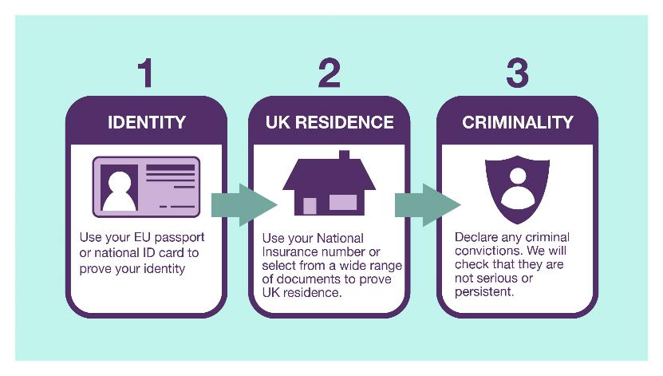

Slide 18
There are three ways for applicants to verify their identity;
Using the ‘EU Exit ID Document Check app’: This option is currently available on android devices and iPhone 7 up and available to resident EU citizens (and their EU citizen family members) with a valid biometric passport, and to their non-EU citizen family members holding a valid biometric residence card, so that they can prove their identity remotely. There are also local hubs with android devices where applicants can go to have their identity checked remotely. (The closest one to Bradford is in Halifax; it might not be a free service)
Send an identity document in the post: This will allow caseworkers to check applicants identity as part of the application process.
Face to face: Applicants can have their identity verified face to face, in one of the passport offices across the UK. (it’s usually chargeable service)
You can apply to EU Settlement Scheme and complete the application on ANY device with an Internet Access.
Proving you identity and completing the application for Settled Status (Settled and Pre-settled – both called a Settled Status) is separate task.
On 21

Slide 19
The application form will ask if an applicant has any criminal convictions, both in the UK and overseas. Applicants will be checked against the UK’s crime databases.
If the applicant has any convictions including spent convictions it must be declared. Only Immigration Adviser LEVEL 2 and above can deal with the caseload. At the moment only CHAS @St Vincent and Garlington Advice Centre offers a free support on level 2 as those 2 organisations have been funded by BMDC and Home Office .
You can appoint your own private immigration adviser / solicitor but you would have to pay their standard fee
This is to determine an applicant is not a serious or persistent criminal, and that the applicant doesn’t pose a security threat. If an applicant has been convicted of a minor crime, they will still be eligible for either pre-settled status or settled status.
An applicant may still get pre-settled status or settled status even if they have other convictions. All of these applications will be assessed on a case-by-case basis.
If an applicant has been to prison, that time does not count as residence in the UK but they are still able to apply to the EU Settlement Scheme where they are released before the ‘specified date’.

Slide 20
PART 3
EVIDENCE OF RESIDENCE

Slide 21
Evidence that covers longer periods of time
Documents that cover a longer period of time between 2 dates include:
annual bank statement or account summary, showing at least 6 months of payments received or spending in the UK
employer letter confirming employment and evidence that the employer is genuine, for example, their Companies House Number
council tax bill
letter or certificate from your school, college, university or other accredited educational or training organisation showing the dates you enrolled, attended and completed your course
invoice for fees from your school, college, university or other accredited educational or training organisation and evidence of payment
document showing a UK address from a student finance body in England, Wales, Scotland or Northern Ireland or from the Student Loans Company.

Slide 22
Evidence that covers longer periods of time
residential mortgage statement or rental agreement and evidence of payment
letter from a registered care home confirming your residence there
employer pension contributions
annual business account of a self-employed person
a P60 for a 12-month period – your P60 shows the tax you’ve paid on your salary in the tax year (6 April to 5 April).
a P45 showing the length of your previous employment. You should get a P45 from your employer when you stop working for tchem
Home Office may ask you for additional evidence to confirm that you were resident here for at least 6 months of that period.

Slide 23
Evidence that covers shorter periods of time
These documents count as evidence for 1 month if they have a single date on. They can be used to cover a longer period of time if they have a start and end date covering longer than a month.
bank statement showing payments received or spending in the UK
payslip for a UK-based job
water, gas or electricity bill showing a UK address
landline or mobile telephone, TV or internet bill showing a UK address
domestic bill, such as for home repairs, vet’s services or insurance, and evidence of payment
card or letter from your GP, hospital or other healthcare professional confirming appointments you have made or attended
letter from a government department, public service or charity that show you dealt with them on a particular date or for a particular period (for example Job Centre Plus or Citizens Advice)
passport stamp confirming entry at the UK border
used travel ticket confirming you entered the UK from another country
invoice for work you have done in the UK and evidence of payment

Slide 24
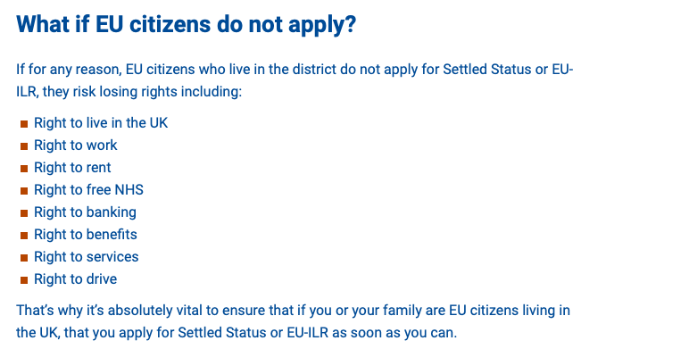

Slide 25
During the Implementation Period, EU citizens will continue to be able to use their passports or ID cards to evidence their rights and entitlements. These online services provide them with an alternative way to demonstrate this
The Home Office is developing a range of online services, enabling migrants to access their immigration status, and prove their entitlement to a range of public and private services – such as work, rental accommodation, healthcare and benefits
An online Right to Work service – enabling holders of Biometric Residence Permits (BRP) and Biometric Residence Cards (BRC) to check their own right to work status and share this securely with employers went live in April 2018.
An online status service has been developed for those granted status under the EU Settlement Scheme – ‘view and prove your rights in the UK’. You can share you status with your employer (you would need work email address to do so). Employer then will be given the code via work email. Employer must download your proof of a status and keep it within your files.
This service will be further developed as the scheme launches, enabling users to share their rights with other service providers, such as landlords, and will continue to iterate and improve these services based on user feedback

Slide 26
Useful information for social services workers working with vulnerable families including EU families FAMILY STAR
https://www.gov.ie/en/campaigns/b2c18-getting-ireland-brexit-ready/?referrer=http://www.gov.ie/brexit/
https://www.gov.ie/en/publication/2b41b2-daily-life/
https://www.gov.ie/en/publication/2b41b2-daily-life/#healthcare
https://www.gov.ie/en/policy-information/b42e94-health-and-brexit/?referrer=http://www.health.gov.ie/brexit-contingency-and-preparedness-update/
https://www.gov.ie/en/publication/1a1e1d-living-and-working/
https://www.gov.ie/en/publication/1a1e1d-living-and-working/#social-welfare-rights-and-entitlements
https://www.gov.ie/en/publication/1a1e1d-living-and-working/#education
https://www.gov.ie/en/publication/ac159f-travelling-and-visiting/

Slide 27
THANK YOU FOR YOUR ATTENTION
ALEKSANDRA MARCINKOWSKA – IMMIGRATION ADVISER / EDUCATOR/ THERPIST
OFFICE @EDUSMART- TC.NET.COM
WWW.EDUSMART-TC.NET.COM
DIALOG OF Transformation ®
FAMILY STAR

